Slide 1
EISENMENGER SYNDROME
DR.ARAVIND KUMAR K
SR CARDIOLOGY
DEPT OF CARDIOLOGY
GOVT CALICUT MEDICAL COLLEGE

Slide 2
REFERENCES:
Braunwald’s Textbook Of Cardiovascular Medicine, 12th e
Perloff’s Clinical Recognition of Congenital Heart Diseases, 7th e
Arvanitaki A, Gatzoulis M, Opotowsky A, et al. Eisenmenger Syndrome. J Am Coll Cardiol. 2022 Mar, 79 (12) 1183–1198
Bouzas B, Gatzoulis MA. Pulmonary arterial hypertension in adults with congenital heart disease. Revista Española de Cardiología (English Edition)2005 May 1;58(5):4659
Kaemmerer H, Mebus S, Schulze-Neick I, Eicken A, Trindade PT, Hager A, Oechslin E, Niwa K, Lang I, Hess J. The adult patient with eisenmenger syndrome: a medical update after dana point part I: epidemiology, clinical aspects and diagnostic options. Curr Cardiol Rev. 2010 Nov;6(4):343-55.

Slide 3
REFERENCES:
2022 ESC/ERS Guidelines for the diagnosis and treatment of pulmonary hypertension
D'Alto M, Diller GP. Pulmonary hypertension in adults with congenital heart disease and Eisenmenger syndrome: current advanced management strategies. Heart. 2014 Sep;100(17):1322-8
Oechslin E, Mebus S, Schulze-Neick I, Niwa K, Trindade PT, Eicken A, Hager A, Lang I, Hess J, Kaemmerer H. The Adult Patient with Eisenmenger Syndrome: A Medical Update after Dana Point Part III: Specific Management and Surgical Aspects. Curr Cardiol Rev. 2010 Nov;6(4):363-72
Huang JB, Liang J, Zhou LY. Eisenmenger syndrome: not always inoperable. Respir Care. 2012 Sep;57(9):1488-95. doi: 10.4187/respcare.01418. Epub 2012 Feb 17. PMID: 22348268.

Slide 4
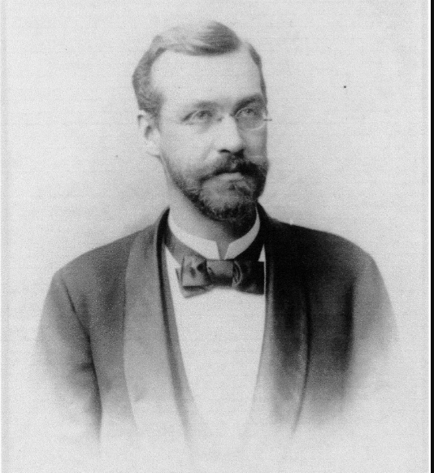
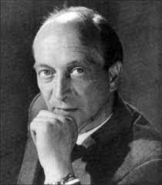
INTRODUCTION
Eisenmenger syndrome (ES)- first described by Victor Eisenmenger in 1897 in a 32-year-old man with cyanosis and dyspnea since infancy secondary to an unrestricted ventricular septal defect who died of massive pulmonary hemorrhage
Later in 1958, Paul Wood defined in pathophysiologic terms as
“pulmonary hypertension (PH) at systemic level, caused by a high pulmonary vascular resistance (PVR), with reversed or bidirectional shunt at aorto-pulmonary, ventricular, or atrial level”

Slide 5
Definition
ES indicates any large congenital cardiac defect, no matter where it is located, permitting increased pulmonary blood flow and transmission of elevated pressure to pulmonary circulation, causing a balanced or predominant right-to-left shunt secondary to a fixed and markedly elevated pulmonary vascular resistance
Hemodynamically, Eisenmenger syndrome (ES) is defined as an elevation of the pulmonary vascular resistance to 12 Wood Units or to a pulmonary-to-systemic resistance ratio equal to or greater than it.

Slide 6
EPIDEMIOLOGY
Eisenmenger syndrome accounted for 8% of the first 1000 cases of CHD in Paul Wood’s cardiology practice
Of a total of 727 consecutive patients with a systemic-pulmonary communication, 127 (17%) had an Eisenmenger reaction
The overall frequency of Eisenmenger reaction
Common atrioventricular septal (canal) or primum ASD(43%)
Ventricular septal defect (16%)
Patent ductus arteriosus (16%)
Atrial septal defect (6%)
Notes:
Recent studies – 50% in VSD, 10% in ASD ,100% in truncus

Slide 7
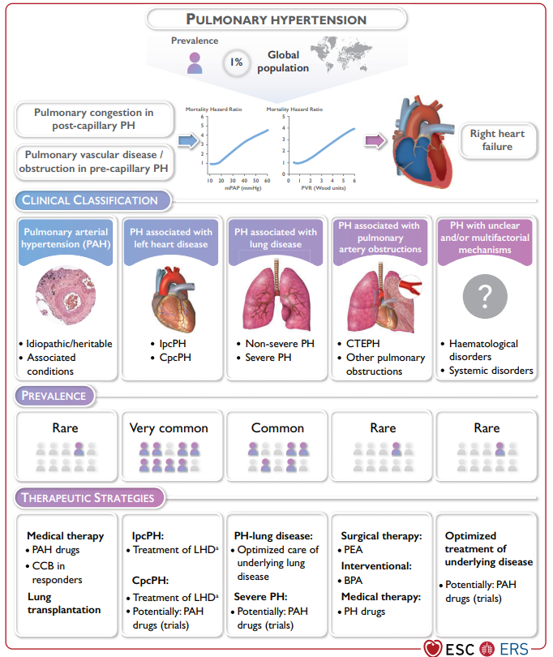

Slide 8
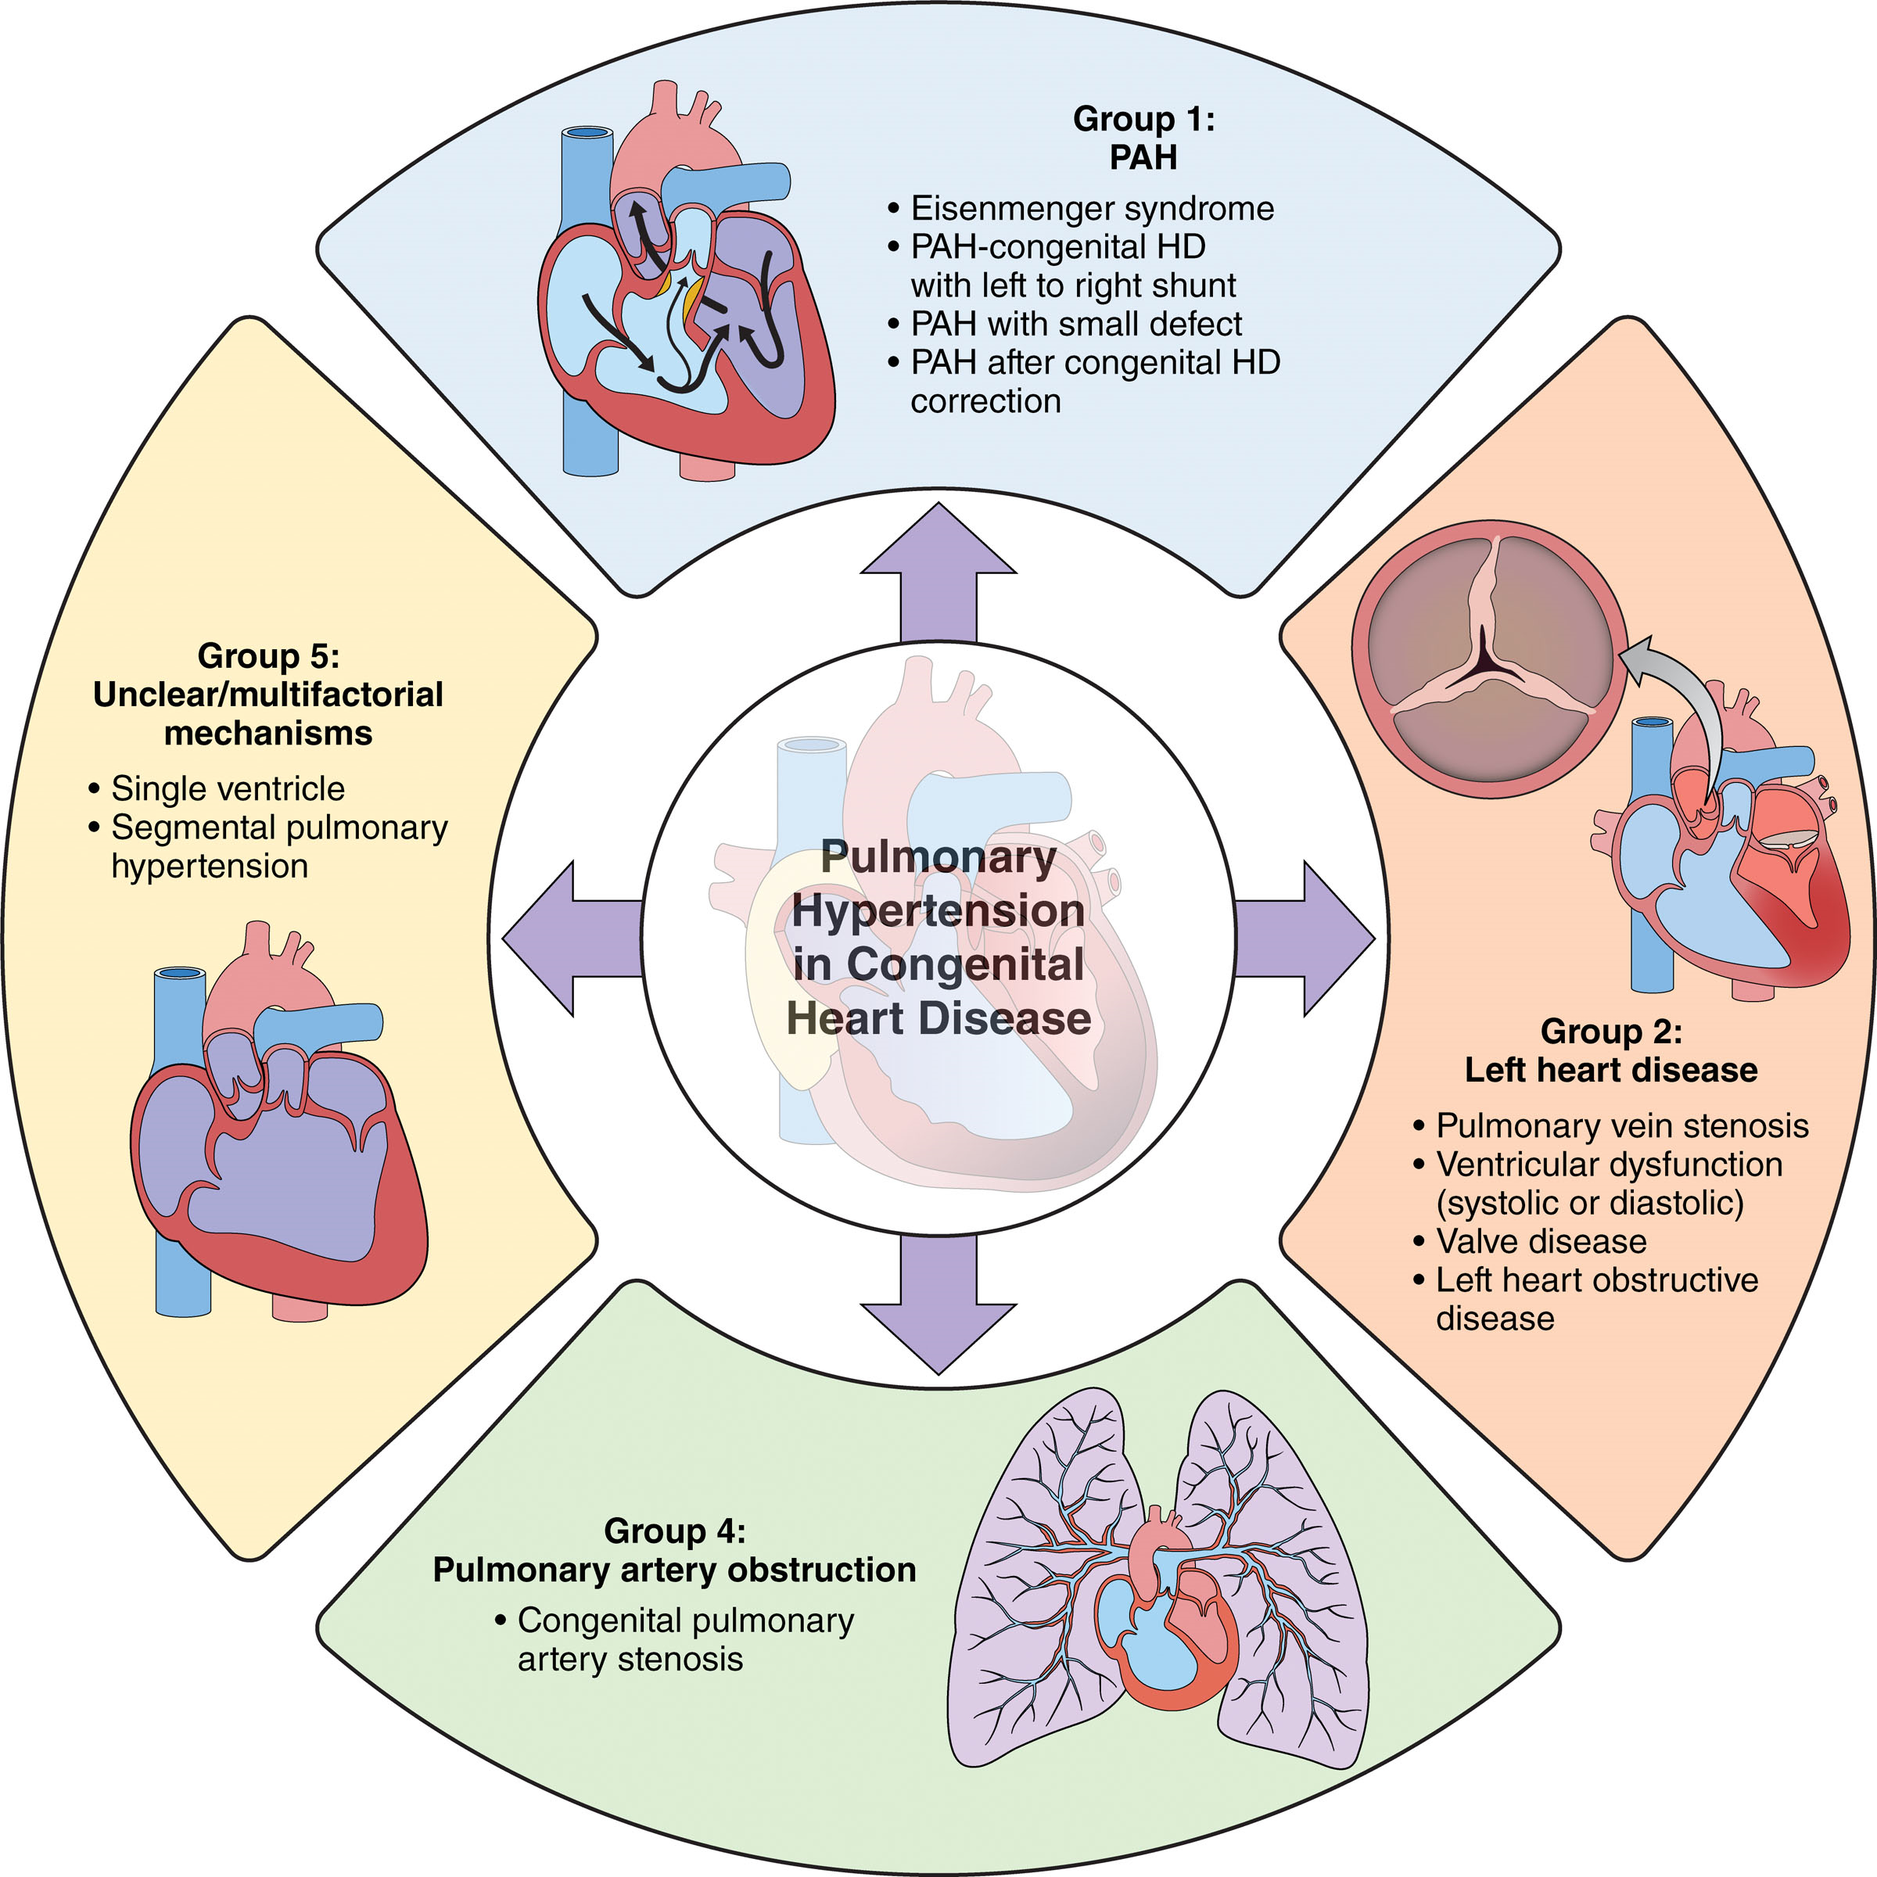

Slide 9
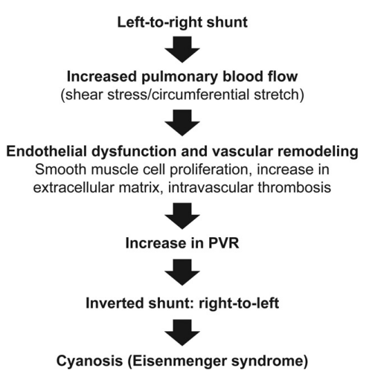
PATHOPHYSIOLOGY

Slide 10
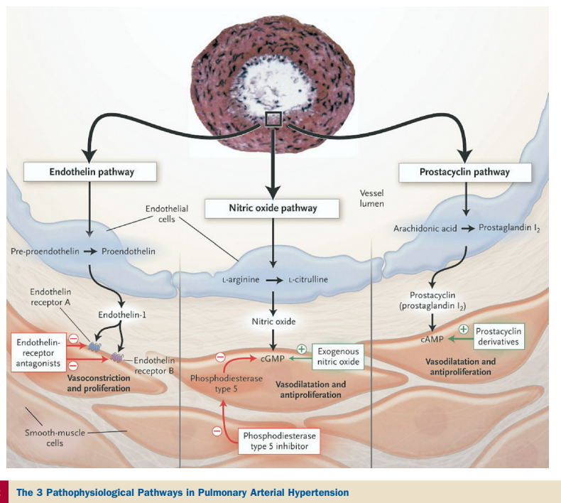

Slide 11
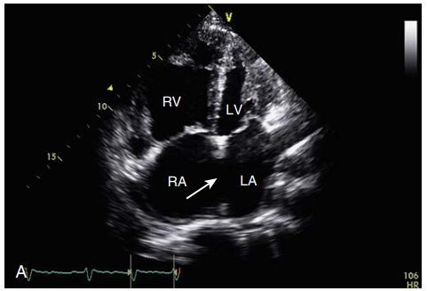
SHUNT AT ATRIAL LEVEL
Partial and total anomalous pulmonary venous drainage – Fixed shunt
Sinus venosus defects
Atrial septal defects – increased RV volume
Common atrium
When RV diastolic compliance fails, reversal of shunt develops(usually 3rd or 4th decade)

Slide 12
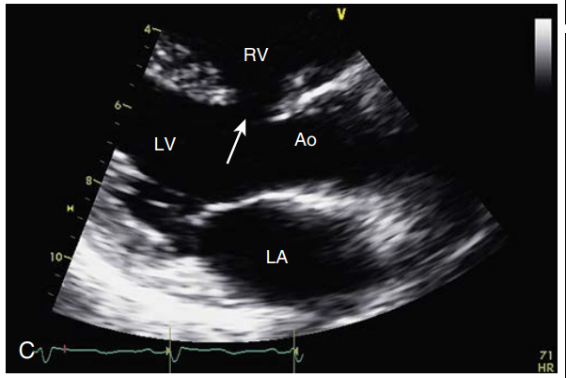
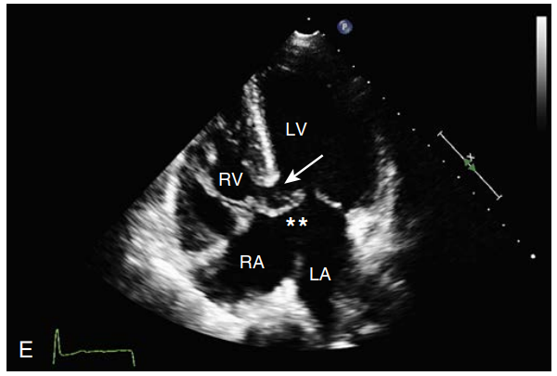
SHUNT AT VENTRICULAR LEVEL
Atrio-ventricular septal defects – adds atrial shunt physiology
Ventricular septal defects –depends on size of shunt and pressures of chambers
Single ventricle

Slide 13
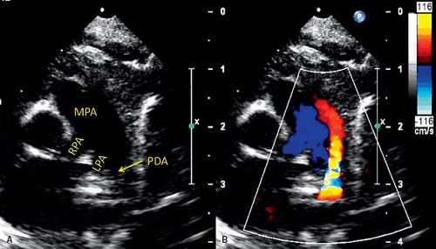
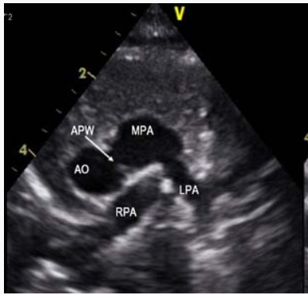
SHUNT AT ARTERIAL LEVEL
Aortopulmonary window
Persistent ductus arteriosus
Truncus arteriosus
Delivers blood flow and systemic pressure to the pulmonary vascular tree continuously during both systole and diastole
Early and rapidly progressive rise of pulmonary vascular resistance

Slide 14
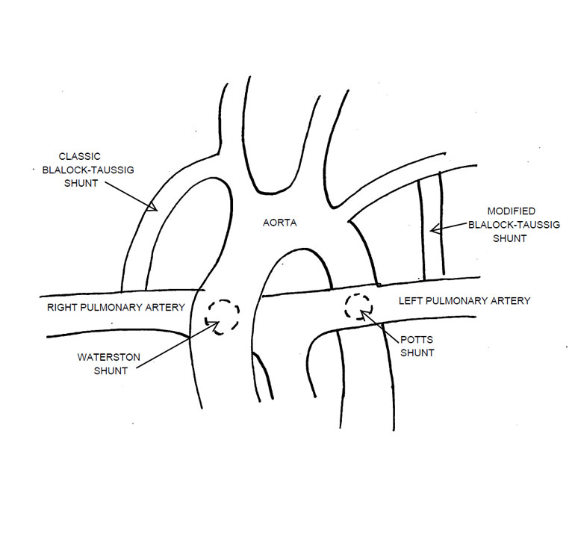
POSTOPERATIVE COMMUNICATIONS
Postoperatively if communications between the systemic and pulmonary circulation persist – Eisenmenger physiology occurs
Surgically created systemic arterial to pulmonary shunts
Waterston- and Pott-shunts
Rarely Blalock-Taussig anastomosis

Slide 15
CLINICAL EXAMINATION

Slide 16
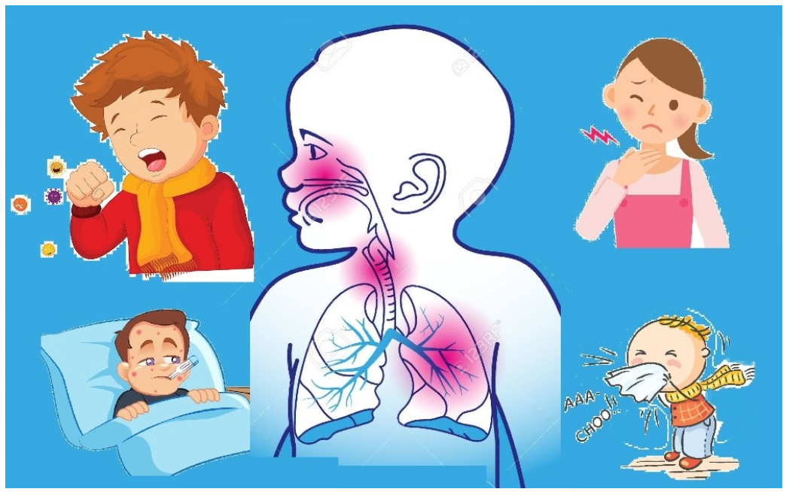
HISTORY
History of pulmonary congestion during infancy due to the left-to-right shunt with increased pulmonary blood flow
With increasing pulmonary vascular resistance, the pulmonary flow declines and pulmonary congestion decreases
The shunt will reverse and the patients become cyanotic with further increase in pulmonary vascular resistance.

Slide 17
CLINICAL SIGNS AND SYMPTOMS
Dyspnea on exertion
Fatigue
Syncope due to low systemic cardiac output
Neurologic abnormalities (e.g. headache, dizziness, visual disturbances) due to secondary erythrocytosis and hyperviscosity
Congestive right heart failure
Arrhythmias

Slide 18
Hemoptysis due to pulmonary infarction, rupture of a dilated pulmonary artery or a thin-walled pulmonary arteriole
Bleeding due to coagulation abnormalities or thrombocytopenia
Cerebrovascular accidents due to hyperviscosity, paradoxical embolism, or a cerebral abscess

Slide 19
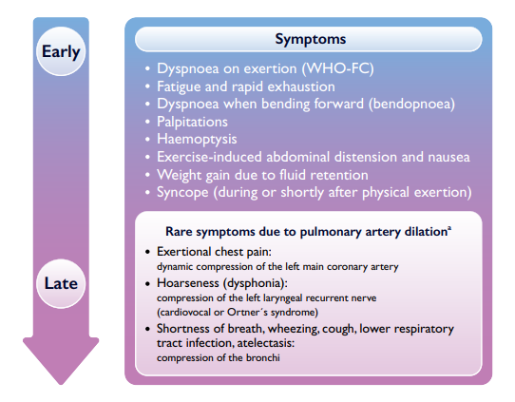

Slide 20
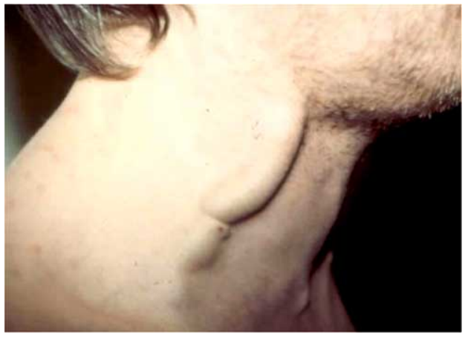
EXAMINATION FINDINGS
Central cyanosis and clubbing(HPOA)
In PDA - differential cyanosis if desaturated blood enters the aorta distal to the left subclavian artery
Arterial pulse is often normal or diminished
JVP is normal without right heart failure
Prominent “a”-wave when systemic venous pressure increases
In tricuspid regurgitation, the jugular venous pressure may be elevated and shows a prominent "v" wave

Slide 21
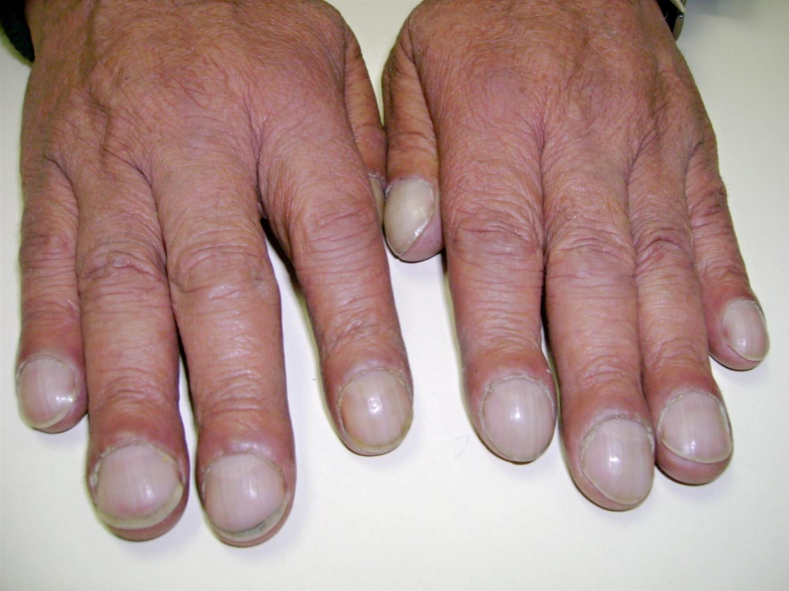
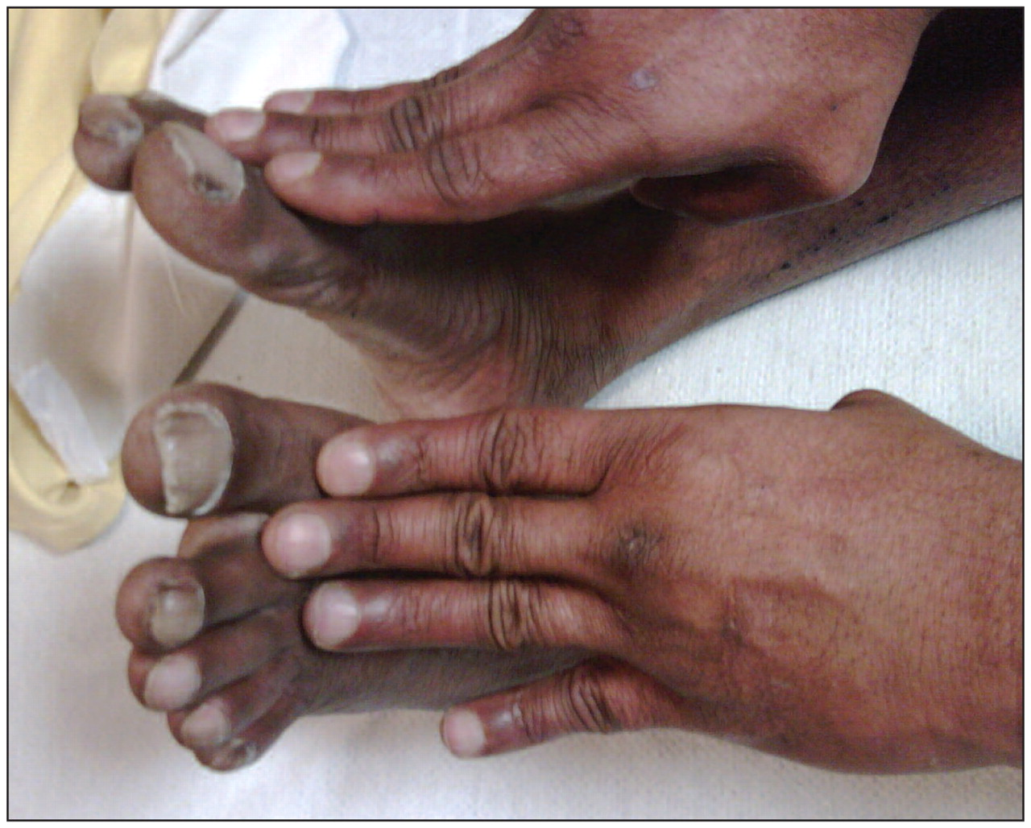

Slide 22
Parasternal lift from the right ventricle palpable in almost all patients
The left ventricular apical impulse is usually absent due to a posterior displacement
At upper left sternal border - a prominent main pulmonary artery impulse is present and a tactual closure of the pulmonary valve
Hepatosplenomegaly or a pulsatile liver occur with right heart failure.

Slide 23
AUSCULTATION
Loud P2
Single S2 (in non-restrictive VSD)
Wide and fixed split S2 (in ASD)
S3 , S4
Isodynamic holosystolic murmur of tricuspid regurgitation
A decrescendo Early diastolic murmur (Graham Steell murmur) (in PR)
Murmurs of a ventricular septal defect or a patent ductus arteriosus are lacking in patients with severe pulmonary hypertension

Slide 24
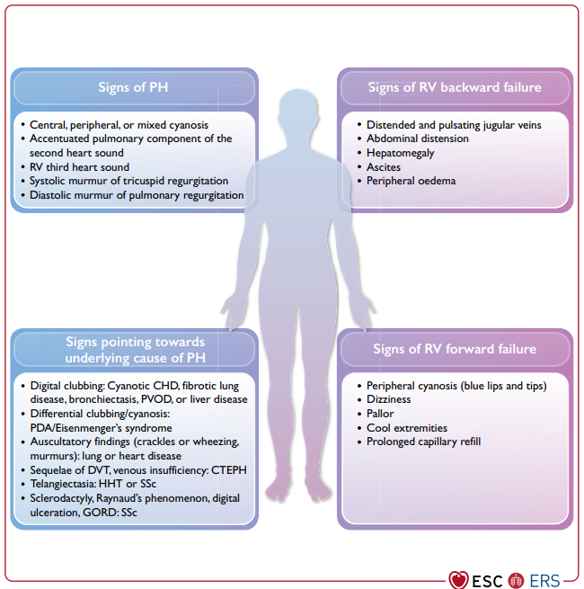

Slide 25
ECG
Right atrial enlargement (P-dextroatriale)
Right axis deviation and right ventricular hypertrophy including tall R wave in V1/2, deep S waves in V5/6 ± ST- and T-wave abnormalities
Left axis deviation - complete or incomplete AV-septal defects
Atrial or ventricular arrhythmias
A first-degree AV-block - AV septal defects.

Slide 28
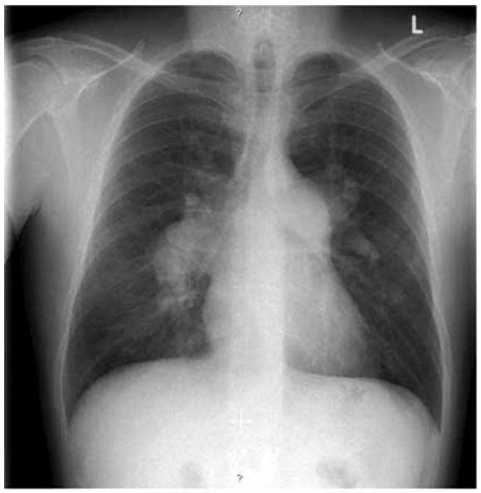
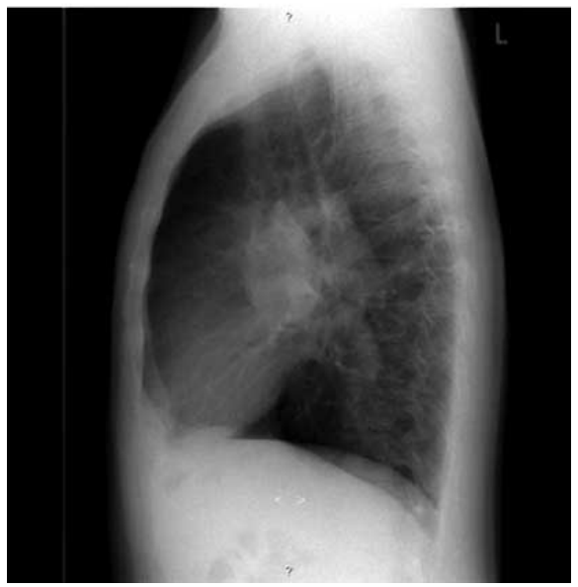
Prominent, dilated main and branch pulmonary arteries and diminished size and number of peripheral vessels (pruning)

Slide 30
JUG HANDLE APPEARANCE IN ES

Slide 31
ECHOCARDIOGRAPHY
RV size
RV wall thickness
RV systolic function
RA dilation
Pulmonary artery pressure

Slide 32
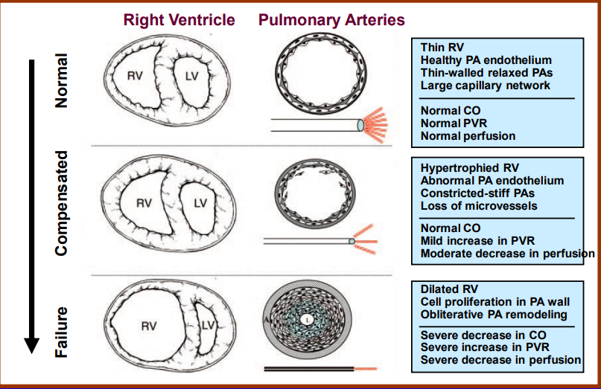
RV CHANGES
RV dilation causes Tricuspid annular dilation→TR
TR+ RV systolic dysfunction worsens afterload

Slide 33
Evaluation of RV size and systolic function include the proximal and distal RV outflow tract (RVOT at end-diastole)

Slide 34
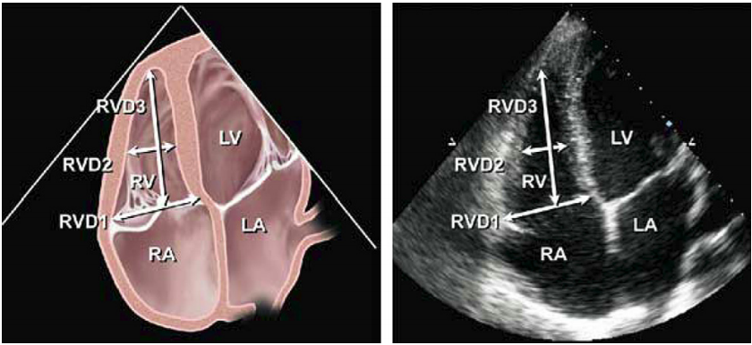
RV SIZE AND DILATION
Level | Diameter
Base | >42 mm
Mid level | >35mm
Longitudinal | >86mm
Proximal RVOT | > 36 mm
Distal RVOT | > 28 mm

Slide 35
RV WALL THICKNESS
Linear measurement of RV free wall on subcostal view
Normal RV wall thickness = 1-5mm

Slide 36
RV SYSTOLIC FUNCTION

Slide 37
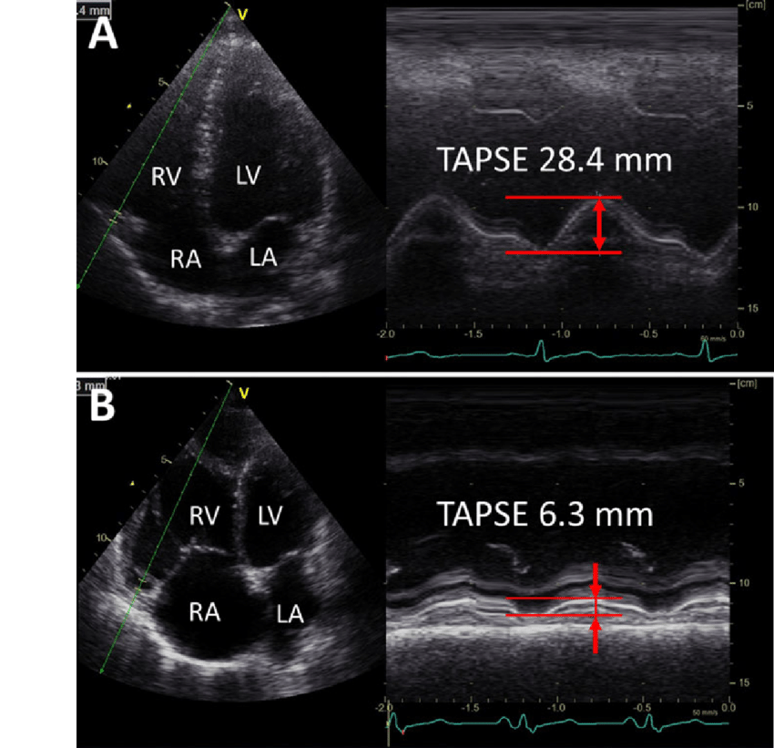

Slide 38
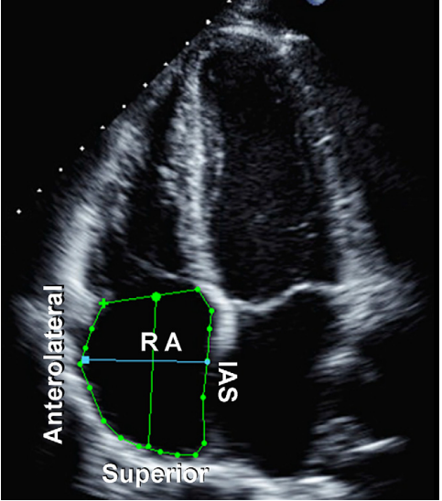
RA DILATION
Major axis dimension < 53 mm
Minor axis dimension < 44 mm
RA area (end- ventricular systole) < 18 cm²

Slide 39
PULMONARY PRESSURES
Tricuspid Regurgitant Velocity (RVP = PAPsystolic = 4(VTR )² + RAP)
Pulmonic Regurgitant Velocity

Slide 40
EXERCISING/CARDIOPULMONARY EXERCISE TEST (CPET)
In patients with pulmonary vascular disease, pulmonary vascular resistance does not display the physiologic decline during exercise
In patients with ES, the unrestrictive bidirectional shunt prevents suprasystemic right ventricular pressure and enables left ventricular filling
A right-to-left shunt at atrial level even augments left ventricular filling and may prevent heart failure during exercise, at the expense of cyanosis during exercise

Slide 41
The amount of right to left shunting depends on the ratio of pulmonary to systemic vascular resistance (Rp/Rs)
In Eisenmenger patients systemic vascular resistance decreases substantially during exercise, whereas pulmonary vascular resistance decreases inadequately
The ratio of pulmonary to systemic vascular resistance, which might be less than 1 at rest, increases to more than 1 during exercise
Severe cyanosis reaching saturations of less than 50% causes dyspnea and makes patients stop exercise

Slide 42
ES AND SPORTS
A recent recommendation for participation in competitive and leisure sport allows only low dynamic sport leisure activities and forbids competitive sports
Patients with ES may not perform scuba diving
Regular exercise training improves endothelial function in systemic vessels even in severe heart failure patients and improves survival

Slide 43
HAEMODYNAMICS/CARDIAC CATHETERIZATION
To determine vascular physiology
To assess pulmonary vascular reactivity to vasoactive substances such as oxygen, nitric oxide and prostacyclin
Blood samples are collected in the superior and inferior vena cava, the pulmonary artery, the left atrium (pulmonary venous wedge position) and in the systemic artery
Measurement is carried out in several conditions: room air, 20-40 ppm nitric oxide, 100% oxygen and nitric oxide 20-40 ppm, inhaled prostacyclin

Slide 44
COMPLICATIONS

Slide 45
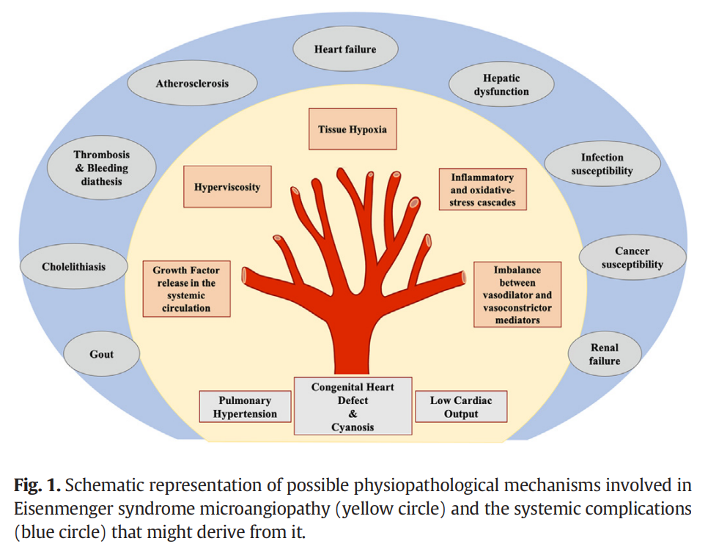

Slide 46
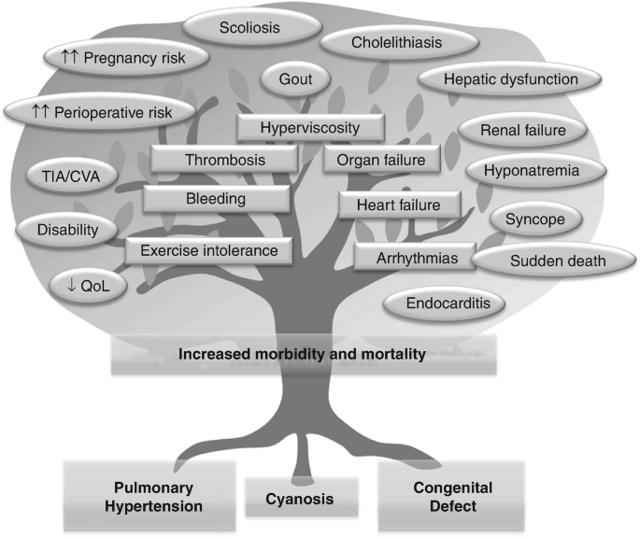

Slide 47
ERYTHROCYTOSIS
Increased erythropoietin production - a physiologic, adaptive response to chronic hypoxemia
Secondary erythrocytosis results in increased shear stress, which modifies the balance between vasodilators and vasoconstrictors
Cyanosis and secondary erythrocytosis affect the pulmonary and systemic vascular system

Slide 48
HEMOSTATIC ABNORMALITIES
Thrombocytopenia and thrombasthenia
Ineffective thrombopoesis
Decreased Vit K dependent clotting fators(II,VII,IX,X)
Increased fibrinolysis
Depletion of large Von Willebrand multimers
Bleeding time is paradoxically shorter in cyanotic patients

Slide 49
THROMBOSIS
Stasis of blood in dilated flow chambers
Coagulation abnormalities
Endothelial injury
Arrythmias

Slide 50
CEREBROVASCULAR EVENTS
Reported in upto 14% of Eisenmenger patients
Can be due to
Paradoxical emboli
Microcytosis by iron defieciency(due to phlebotomies) – strongest independent predictor
Secondary erythrocytosis per se is not a risk factor

Slide 51
Hemoptysis
Rupture of Aorto-pulmonary collaterals
Rupure of Aneurysm of pulmonary artery
Supportive management and selective embolisation

Slide 52
GOUT
Increased production and decreased renal clearance of uric acid
Only recurrent gouty arthritis – treated with uricosurics and uricostatics
Independent long term mortality indicator, hence routinely measured

Slide 53
CHOLELITHIASIS
Due to increased turn over of heme → ↑unconjugated bilirubin
Calcium bilirubinate gall stones → risk of acute cholecystitis
ERCP removal > laparotomy (to avoid GA)

Slide 54
MANAGEMENT
The mainstay of management is targeted PAH therapies
Endothelin receptor antagonists (ERAs)
Phosphodiesterase type 5 inhibitors (PDE-5i)
Prostanoids

Slide 55
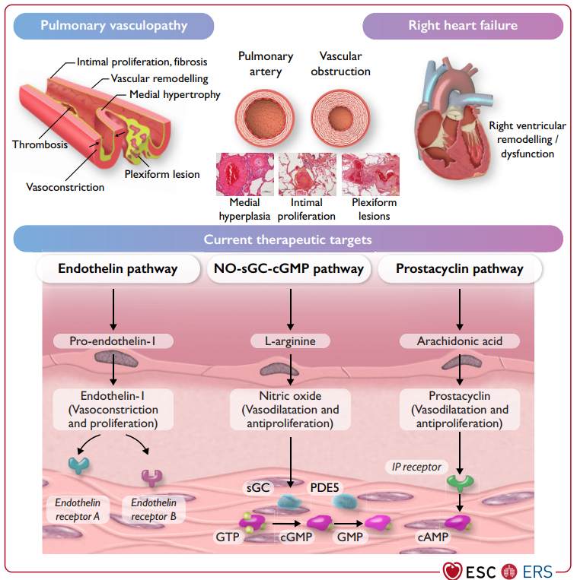
PROSTANOIDS
ERA
PDE-5i

Slide 56
ERA’s
BOSENTAN → ET_{A}:ET_{B} affinity ratio of ∼40:1(proven efficacy)
well tolerated and improved exercise capacity and hemodynamics without compromising peripheral oxygen saturation
AMBRISENTAN – selective ET_{A} receptor antagonist
MACITENTAN - ET_{A}:ET_{B} affinity ratio of ∼50:1 (no proven efficacy)

Slide 57
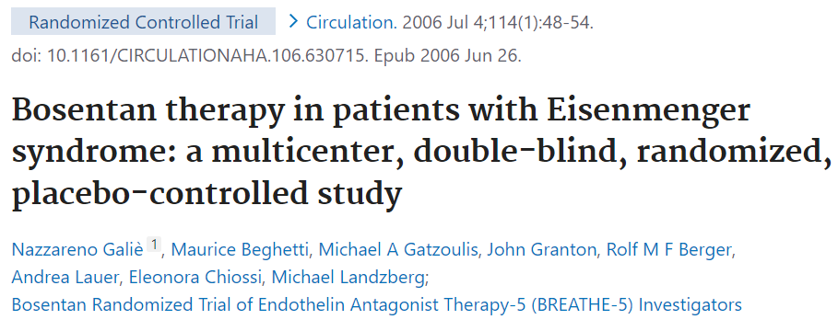

Slide 58
PDE5i
Sildenafil, a selective inhibitor of the (c-GMP)-specific phosphodiesterase type 5, decreases the degradation of cGMP
Local release of nitric oxide and vasodilatation
Intravenous sildenafil →effective as inhaled nitric oxide

Slide 59
PROSTANOIDS
Prostacyclin or epoprostenol is a potent short-acting vasodilator
Improves haemodynamics, exercise performance, and survival
Side effects (nausea, vomiting, dizziness, light headedness, and flushing)
The need for continuous intravenous administration (risk of infection, catheter thrombosis, and rebound symptoms if the infusion is stopped) limit its use

Slide 60
Newer forms of prostacyclin are being developed including inhaled, subcutaneous and oral forms
Iloprost, an aerosolized prostaglandin - shorter half life → requires frequent inhalations
RIOCIGUAT – cGMP enhancer – potent vasodilation- favourable outcomes
Beraprost(in Japan) – orally active prostacyclin analog – no hemodynamic improvement

Slide 61
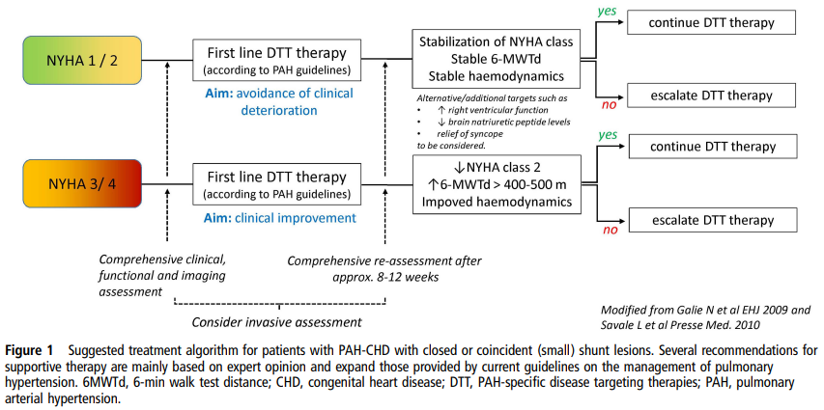

Slide 62
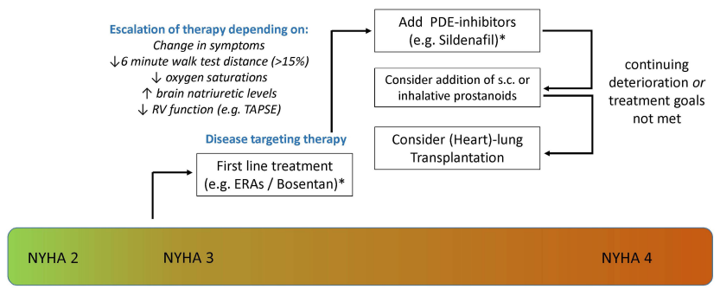

Slide 63
ES AND SURGICAL CORRECTION

Slide 64
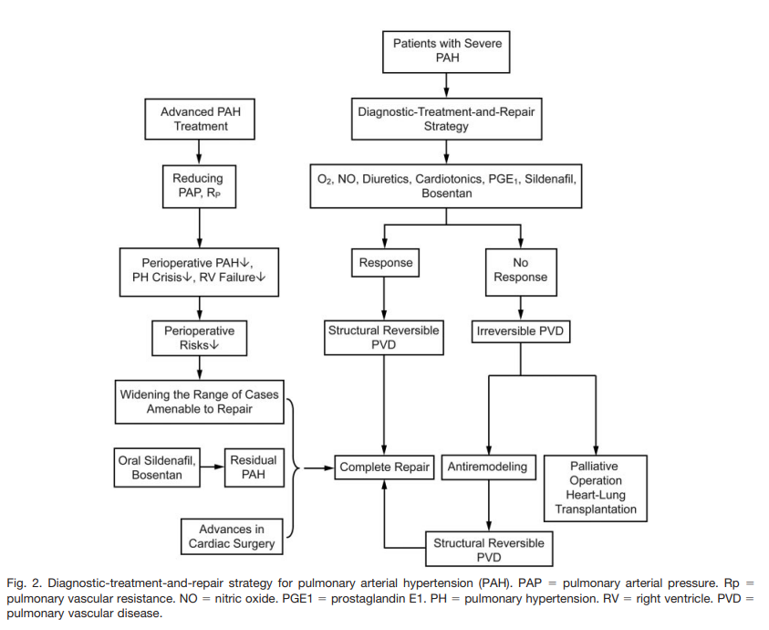

Slide 65
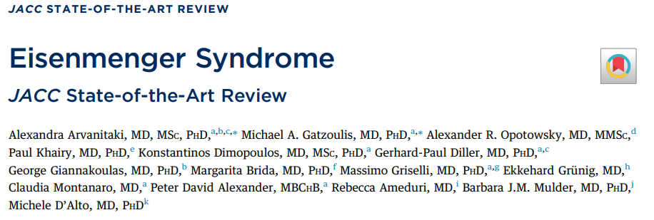
JACC RECOMMENDATIONS -2022

Slide 66
SECONDARY ERYTHROCYTOSIS
No place for routine venesections
If a trial of venesection is considered - Only in expert centers
hemoglobin >22 g/dL
hematocrit >65%
severe hyperviscosity symptoms in the absence of dehydration
At small volumes (250-500 mL) with simultaneous fluid replacement to avoid hemodynamic imbalance
Notes:
HYPER VISCOSITY Sx – head ache , muscle weakness, loss of concentration and fatigue

Slide 67
IRON DEFICIENCY
Check iron profile (transferrin saturation <20%)
Consider gastrointestinal side-effects
Intravenous supplementation - Administer at a slow rate
Take care to avoid air emboli
Periodic blood tests (iron profile/full blood count)
Unclear how long iron supplementation should continue

Slide 68
THROMBOTIC DIATHESIS
Oral anticoagulation should be recommended in
Atrial arrythmia
Presence of PA thrombus or emboli
Vitamin K antagonists remain the oral anticoagulants of choice
Pending safety and efficacy data - direct oral anticoagulants

Slide 69
Hemoptysis
Anticoagulation is not recommended in patients with active or recurrent hemoptysis
Supportive treatment
Manage concomitant respiratory tract infections, suppress coughing, reduce physical activity, treat hypovolemia and (relative) anemia
CTPA to determine the presence and location/origin of intrapulmonary hemorrhage
Coil embolization and Inhaled tranexamic acid may be considered

Slide 70
ARRHYTHMIAS
Prompt restoration and maintenance of sinus rhythm recommended
Catheter ablation - intractable arrhythmia
Transvenous pacing requires anticoagulation
Alternative pacing strategies, including epicardial and leadless systems, may be considered and tailored according to individual patient risk assessment

Slide 71
ICD INDICATIONS
S-ICD(Subcutaneous) may be considered for secondary prevention of sudden cardiac death and for high-risk patients (primary prevention, eg, severe ventricular dysfunction and syncope)
S-ICD should be favored in suitable candidates with ICD indications not needing antibradycardia pacing.

Slide 72
RISK STRATIFICATION AND THERAPY
Risk stratification for all patients based on available predictors and risk scores
Consider starting with an ERA monotherapy in symptomatic (>I WHO FC) patients with reduced functional capacity
Combination therapy (with a PDE5 inhibitor) to optimize patient
Consider escalating to triple combination therapy in selected high-risk patients

Slide 73
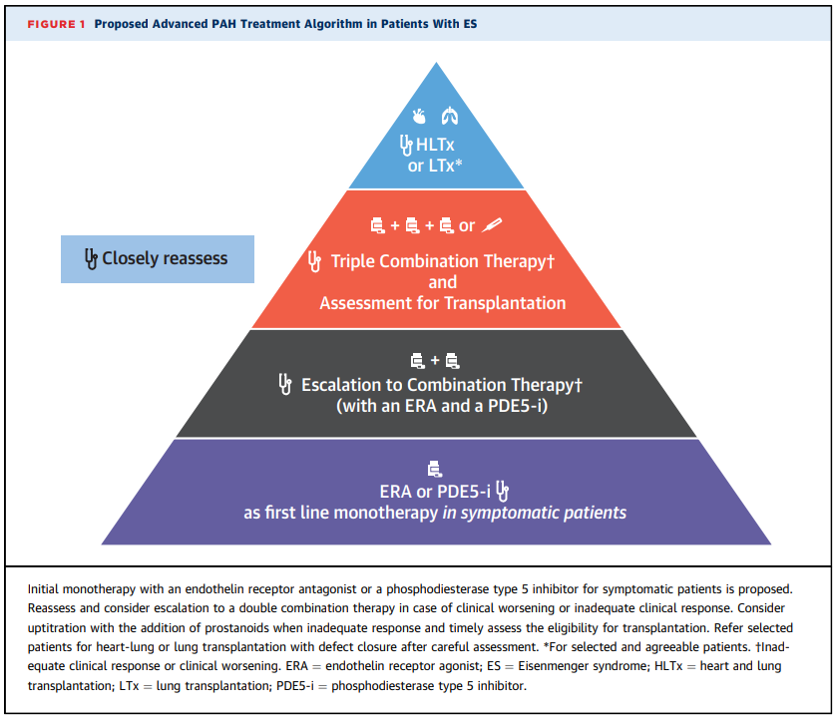

Slide 74
TRANSPLANTATION
Patients at high risk and symptomatic despite optimal PAH therapy should be listed for transplantation
Consider bilateral Lung Tx with shunt repair for patients with an ASD
Consider HLTx for patients with post-tricuspid shunts

Slide 75
PERIOPERATIVE ANESTHESIA
Perform noncardiac surgery only in expert centers by expert anesthesiologists
Maintain a balance between pulmonary and systemic blood flow
Prevent worsening of hypoxemia

Slide 76
PREGNANCY AND EISENMENGER SYNDROME

Slide 77
CONTRACEPTION AND PREGNANCY IN ES
Women with ES should be counselled strongly against pregnancy
Termination Ideally conducted before the 10th week of gestation
Contraception →High-dose estrogen therapy avoided –risk of thromboembolism
Consider double contraception with male/female barrier devices plus slow-release subcutaneous progestin implants, Mirena coil, or male/female sterilization

Slide 78
AVOID DEHYDRATION
Dehydration leads to hypovolemia
Reduction of right ventricular filling pressure
Reduction in pulmonary perfusion, hypoxemia & Fetal distress

Slide 79
THERAPY IN PREGNANCY
ERAs are contraindicated during pregnancy
Prostanoids and PDE-5 inhibitors (monotherapy or combination therapy) reduce hypoxemia and right to left shunting and improve maternal outcomes
Inhaled nitric oxide may be used in the peripartum

Slide 80
PERIPARTUM AND ES
Mode of delivery : Caesarean section and vaginal delivery are both valid options
Regional anesthesia is usually preferred over general anesthesia
Anesthesia could result in significant systemic vasodilatation with worsening of right to left shunting, which must be actively corrected
Limit the duration of labor/epidural anesthesia
Uterine contraction causes autotransfusion, which may increase cardiac output by 25% and thus unbalance the delicate ES hemodynamic status increasing the risk of acute decompensation

Slide 81
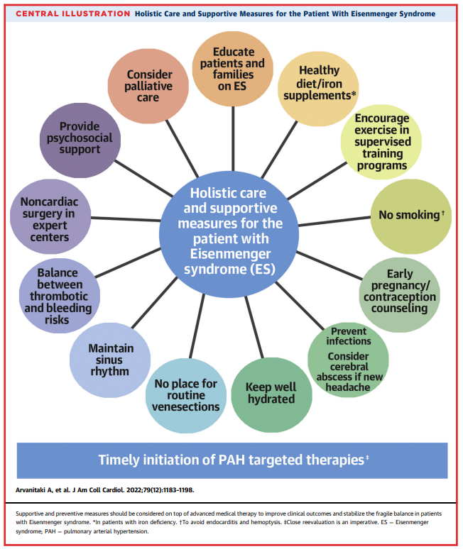

Slide 82
PREDICTORS OF SURVIVAL
Atrial arrhythmias
Function class
Increased precordial ECG voltage as an index of RV hypertrophy
High right atrial pressure
Uric acid
Creatinine
Median survival was 52.6 years (109 patients followed during 6.3 years)
complexity of the underlying congenital heart defect
Age at symptoms or referral to a tertiary care center
Right heart failure symptoms
Syncope
Notes:
Survival of patients with ES is significantly better than in those with other forms of pulmonary arterial hypertension

Slide 83
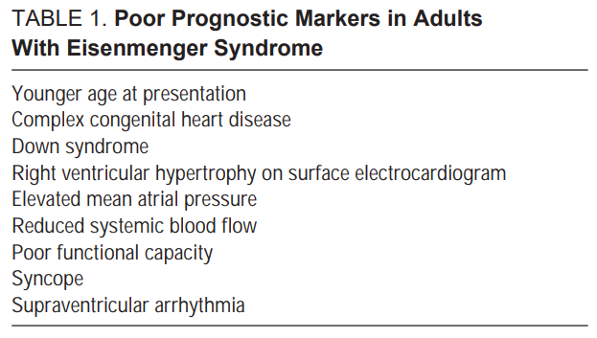

Slide 84
CAUSE OF DEATH IN EISENMENGER SYNDROME
Sudden cardiac death
Congestive heart failure
Hemoptysis
Cerebral abscesses
Thromboembolic events
Complications during pregnancy or due to noncardiac surgery

Slide 85
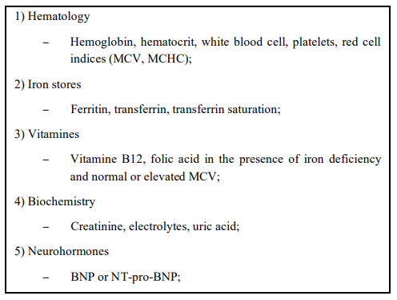
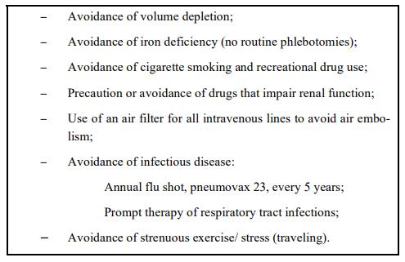
FOLLOW UP
Notes:
Plasma volume is decreased in Eisenmenger patients due to secondary erythrocytosis and elevated hematocrit. Thus, the amount of citrate anticoagulant is excessive for patients with cyanosis and secondary erythrocytosis

Slide 86
IT’S TIME FOR MCQ
1. BREATHE-5 TRIAL is related to
A) Ambrisentan
B) Macitentan
C) Bosentan
2. Choice of anesthesia for pregnancy in Eisenmenger syndrome is
A) Regional anesthesia
B) General anesthesia
C) Both A and B

